Slide 1


Slide 2
Bento provides a platform for users to document inspiration that they see on a daily basis, and be reminded to come back to it and act on it.

Slide 3
Problem:
creative inspiration is scarce. when we forget about things in the world or moments that inspire us, we’re frustrated and our creative process is hindered
Solution:
Bento is a just-in-time solution that helps you actively record your life for moments or pieces that inspire you, and then prompts you to come back and act on this creative inspiration later

Slide 4
Tasks
Simple
setting a reminder for an inspiration entry
Medium
scrolling through a journal of inspiration
Complex
creating an inspiration entry

Slide 5
We observed:
users assume that they would be able to add photos from external sources
so we implemented:
camera roll integration, allowing users to add photos they already have

Slide 6
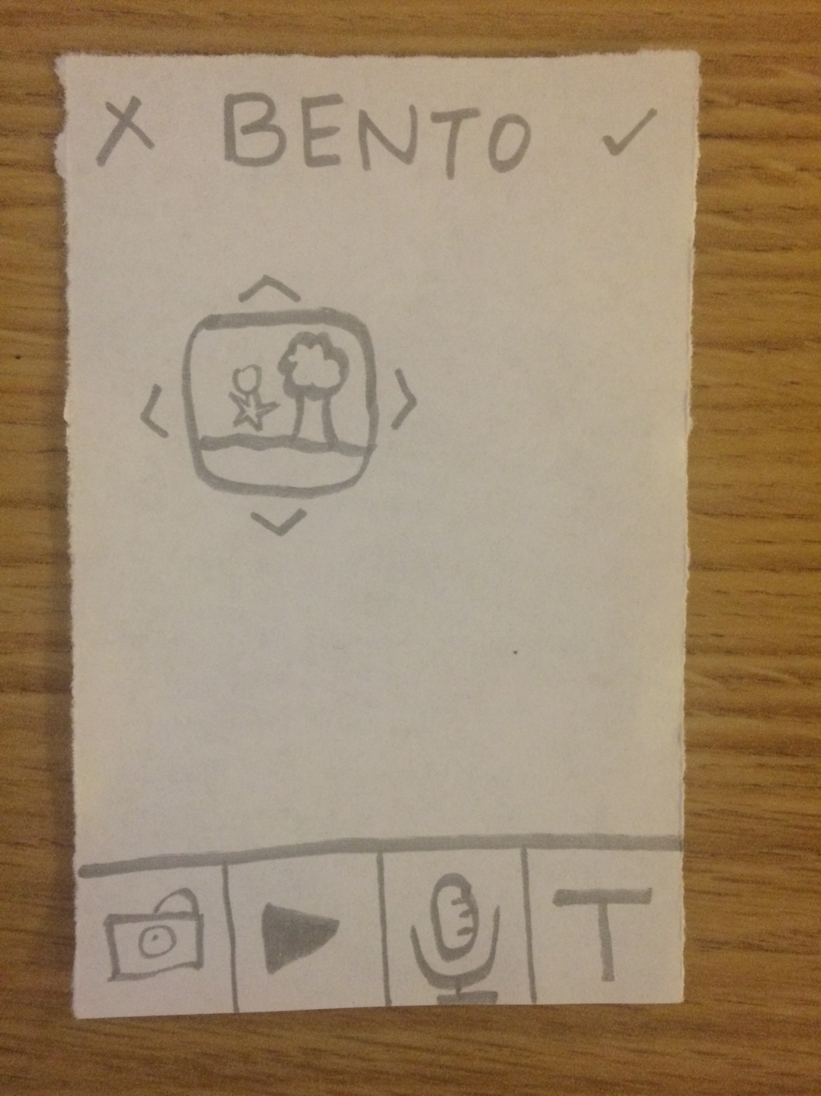
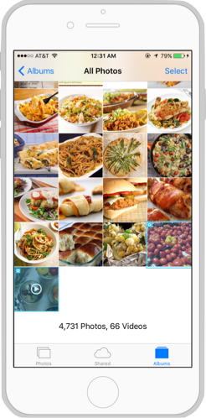
Before:
After:

Slide 7
We observed:
users attempt to press the plus in the middle of the entry screen instead of drag and drop
so we implemented:
click and create, where clicking the plus opens the multimedia addition options, instead of the drag and drop

Slide 8
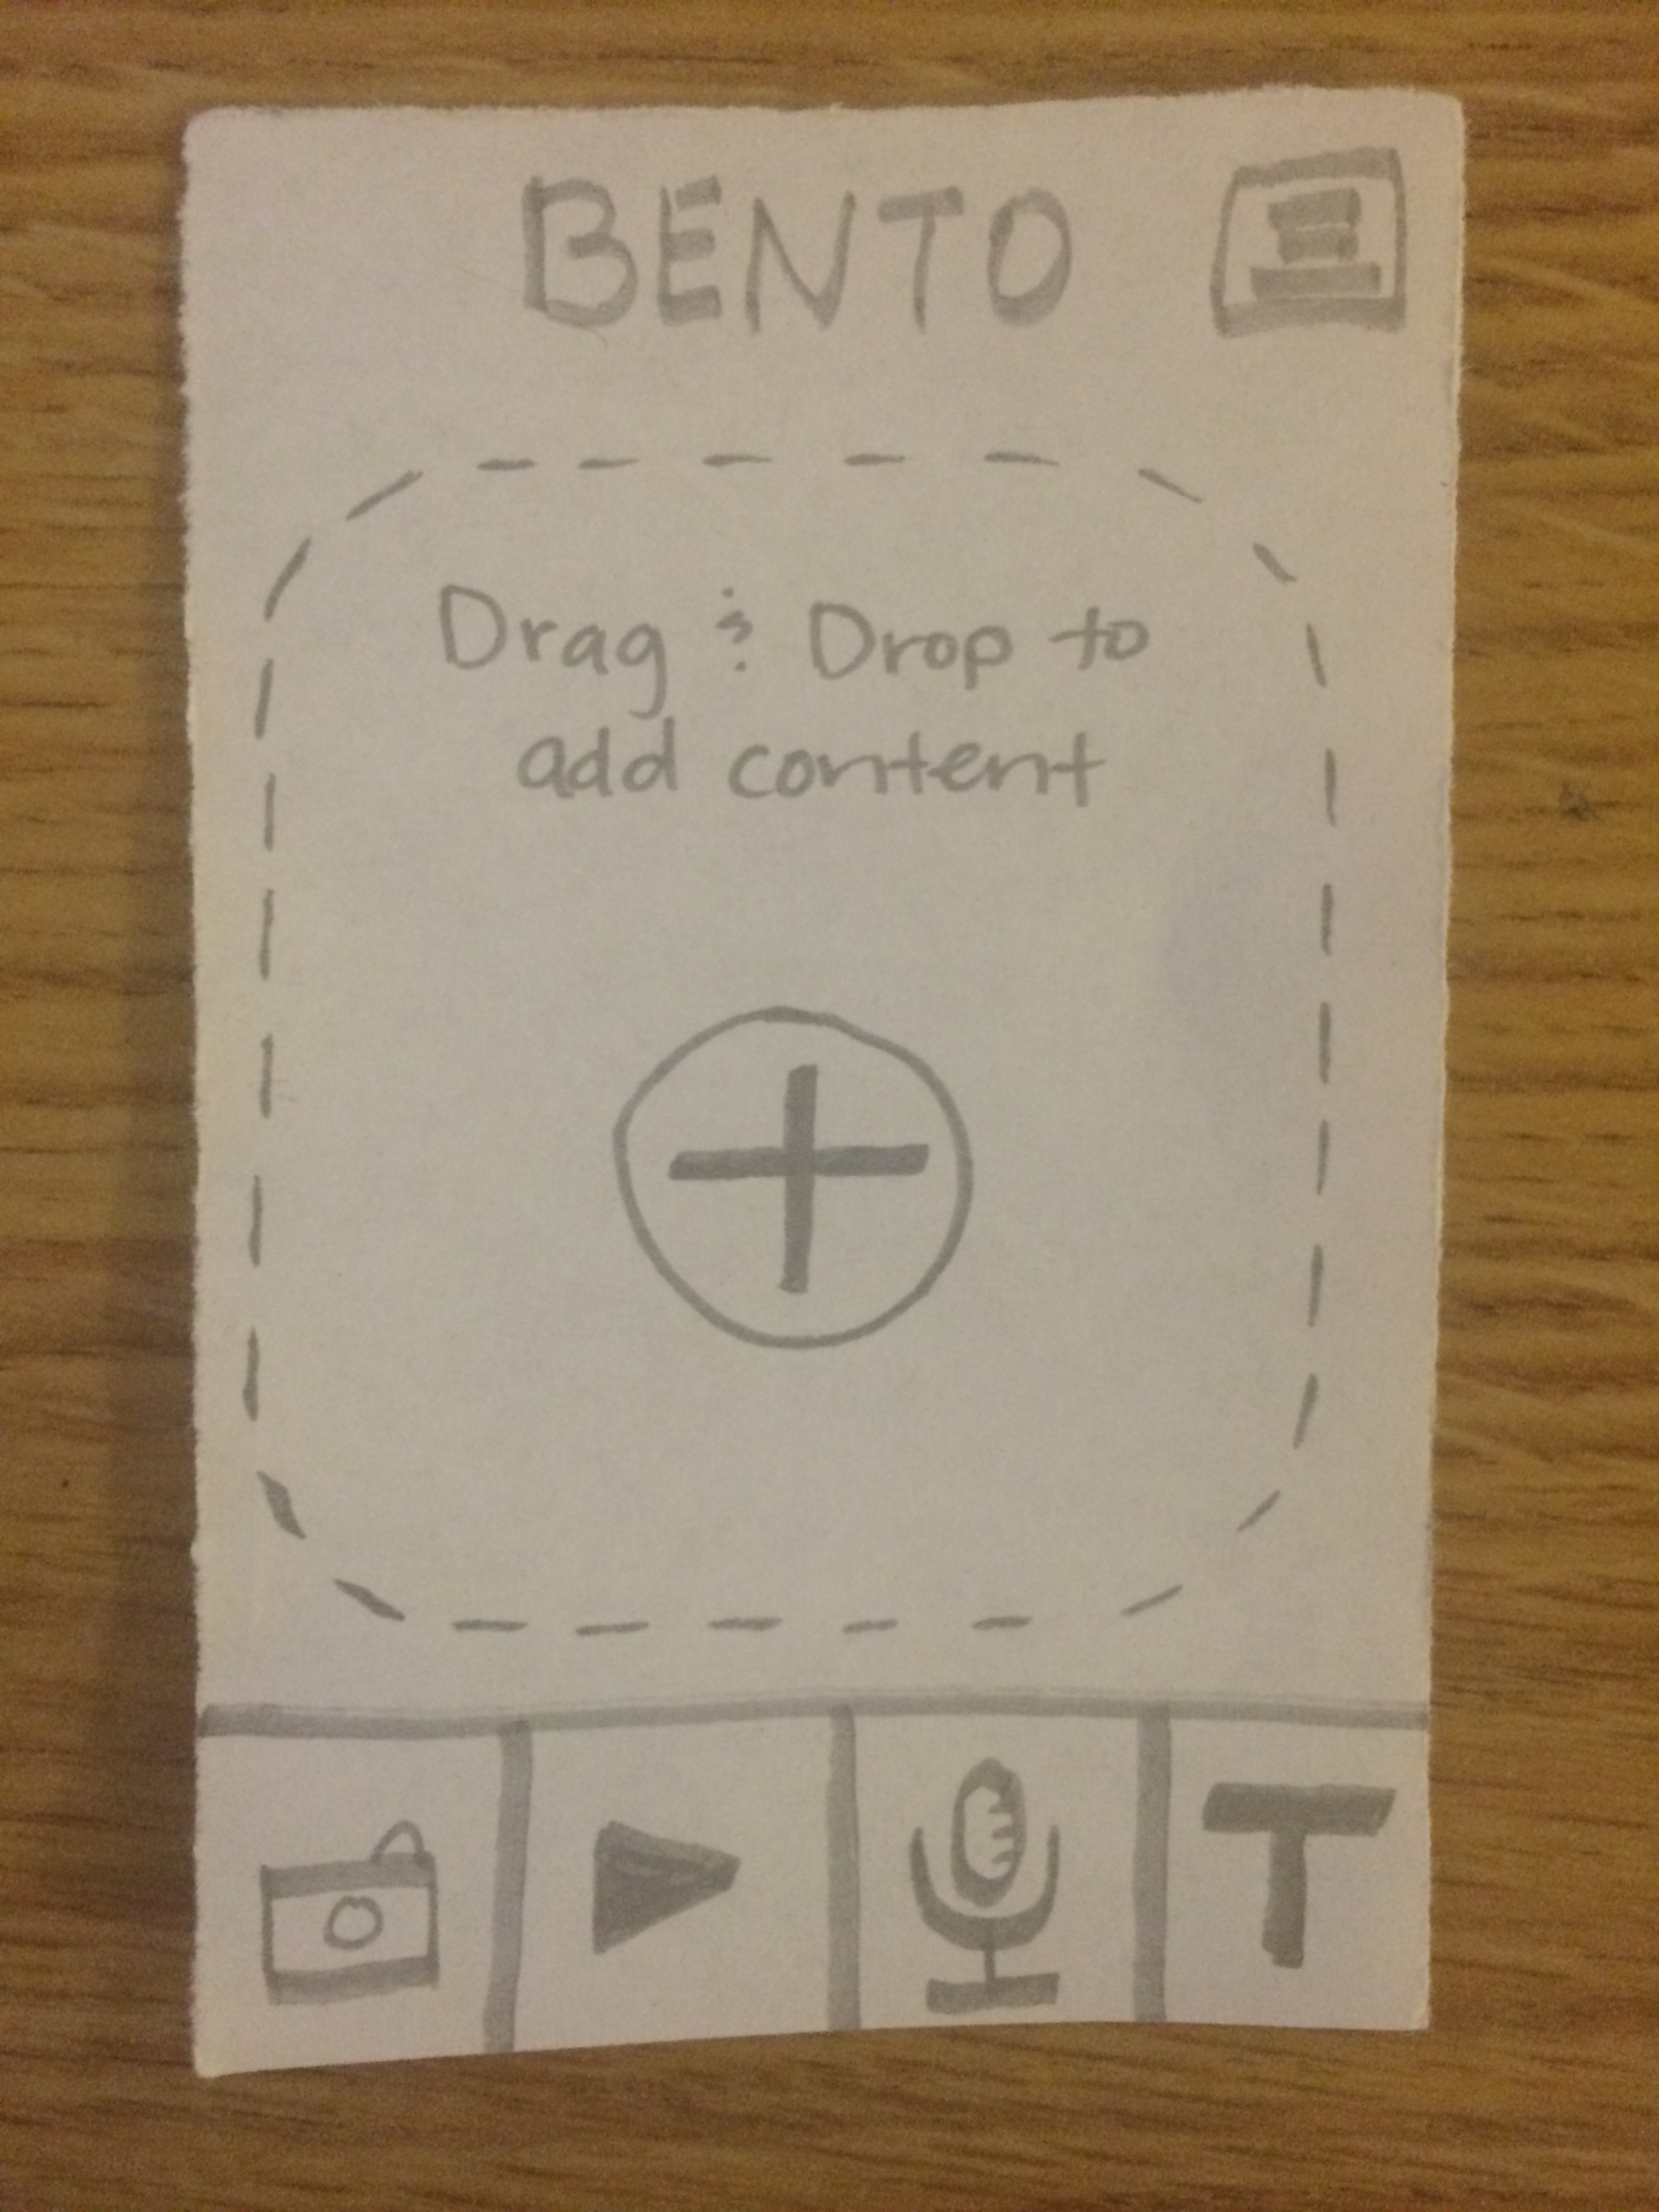
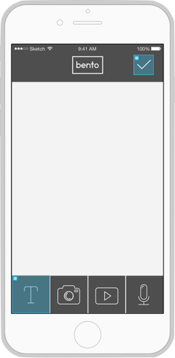
Before:
After:

Slide 9
We observed:
users love being able to move pieces as if they were physical objects
so we implemented:
a constant state of movability, rather than just on entry creation

Slide 10
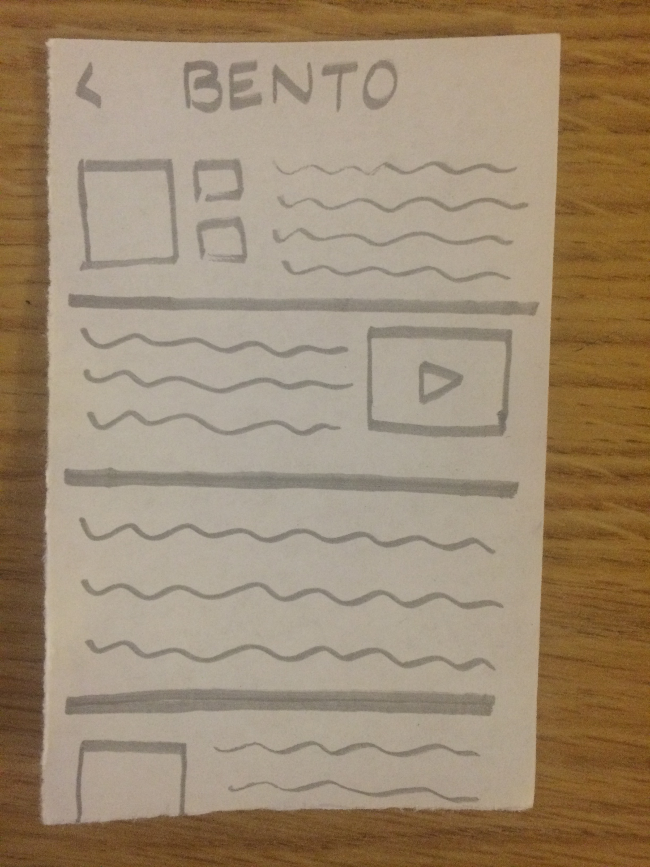
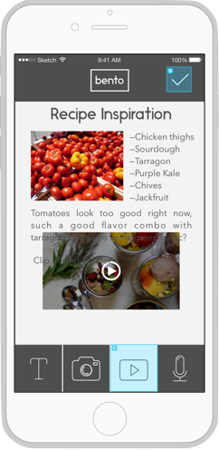
Before:
After:

Slide 11

proto.io

Slide 12
Helpful:
Animations - easy and simple to set up
Transitions and gestures - built in!
Drag and drop interface - easy to use
Preloaded buttons - didn’t have to think about lower level problems

Slide 13
Counterproductive:
Photography - proto.io lacks a mechanism to prototype camera
Documentation - was terrible
Offline HTML - lack of a skin wrapper makes the offline HTML version difficult to get working

Slide 14
Tradeoffs:
Interface - we wanted Pinterest style wiggle/more complex animations, but when learning a new tool, not practical
Camera/Video - unable to prototype dynamic input
Data/Backend - all hardcoded
“Wizard of Oz” - system automatically knowing what kind of reminder to set based on entry

Slide 15
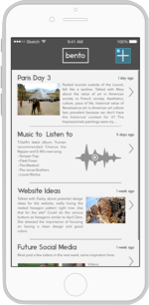
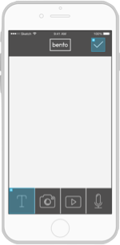
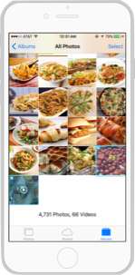
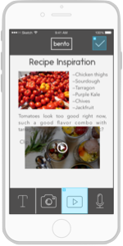
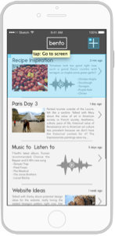

Prototype:

